Slide 1
Artificial Intelligence (Kecerdasan Buatan)
by:
Gregorius S. Budhi
Notes:
Lecture slides by Lawrie Brown for “Cryptography and Network Security”, 4/e, by William Stallings, Chapter 1 “Introduction”.

Slide 2

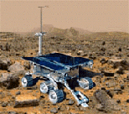
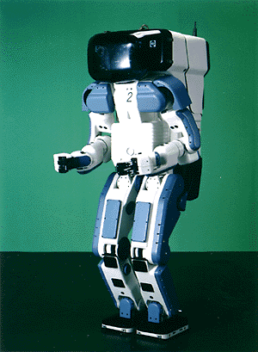

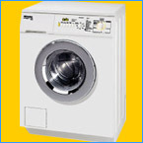
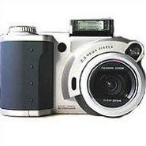

Why study AI?
Search engines
Science
Medicine/
Diagnosis
Labor
Appliances
What else?

Slide 3
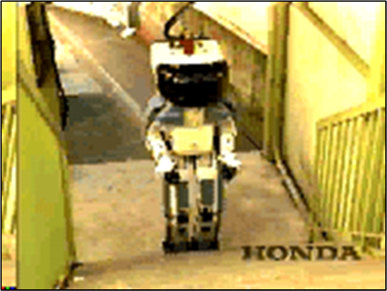
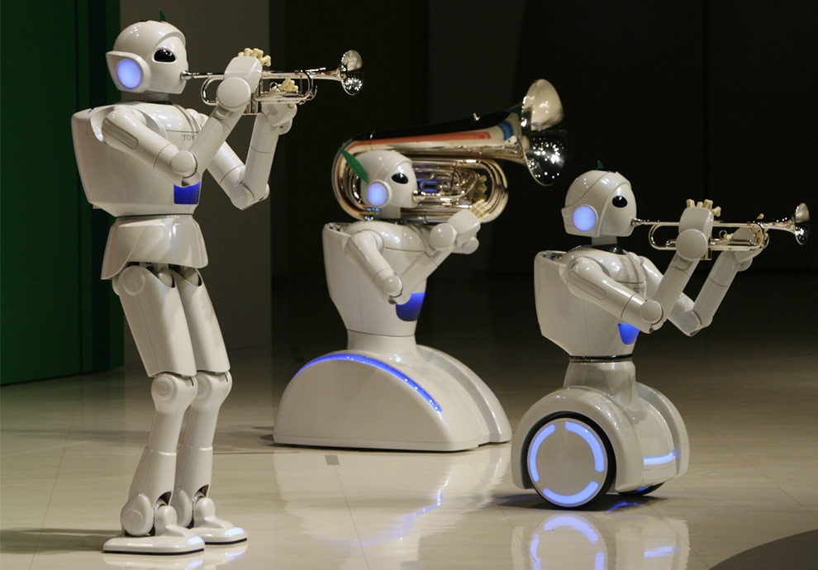
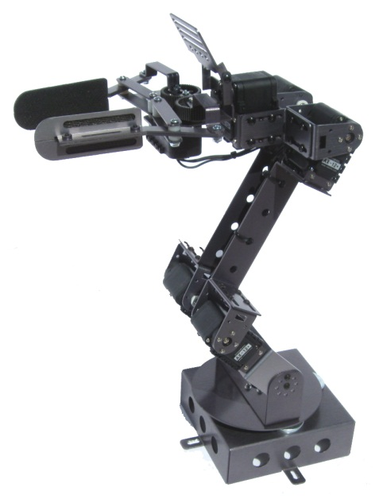
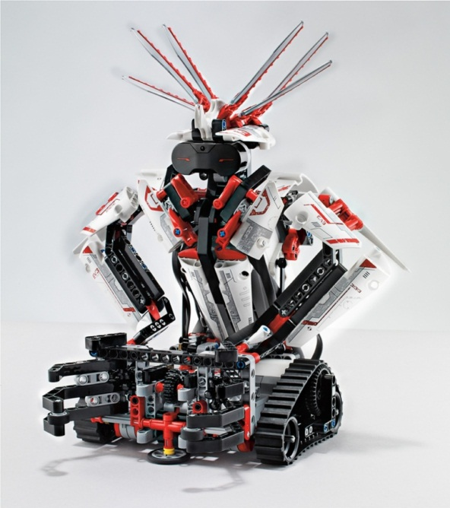
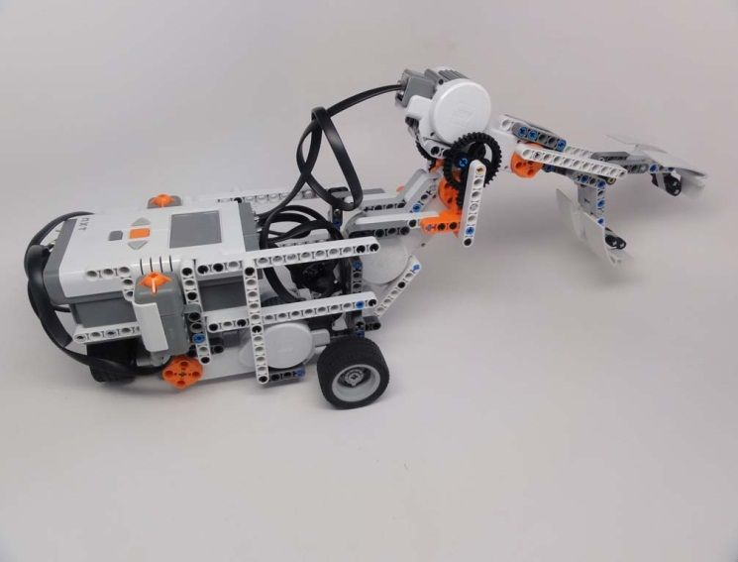
Robot

Slide 4
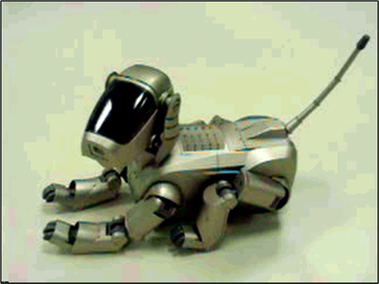
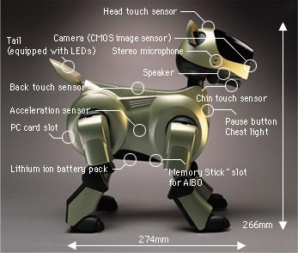
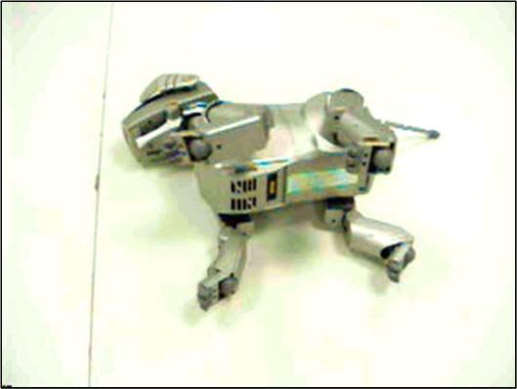
AIBO
http://www.aibo.com

Slide 5
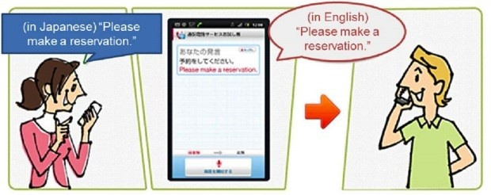
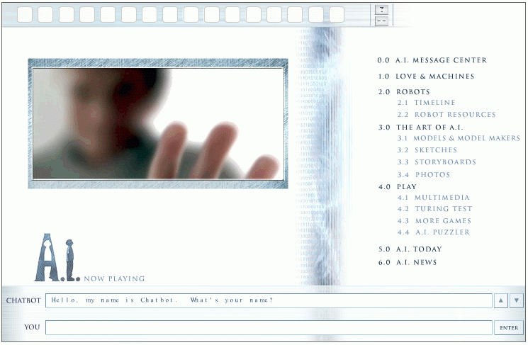
Natural Language Processing
http://www.ai.mit.edu/projects/infolab/

Slide 6
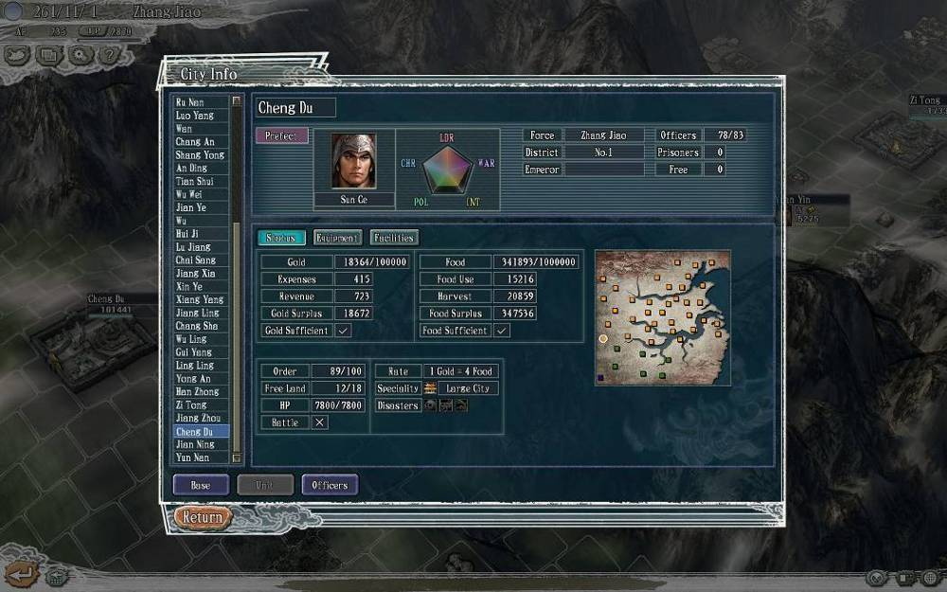
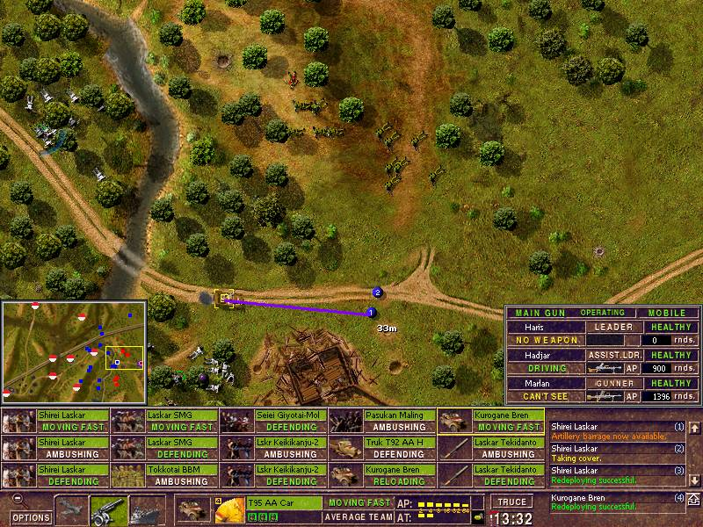
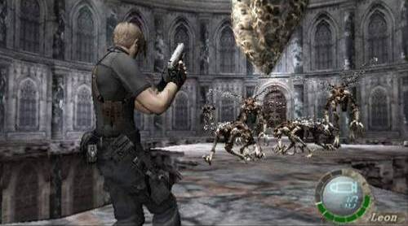
Game Playing
Romance Of The Three Kingdom XI (Strategy Game)
CC5: Battle Of Soerabaja 1945
(War Game)
Resident Evil 4
(Action Game)

Slide 7
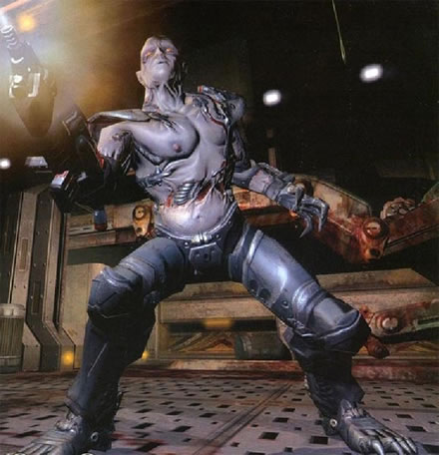

Game Playing
Chase
Retreat
Spawn
Wander
Attack
Low Health
Sound
Dead
Enemy

Slide 8
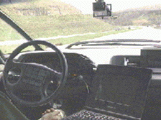
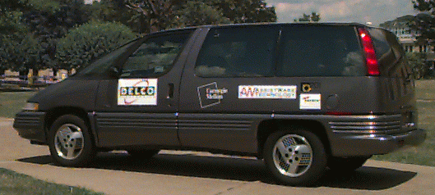
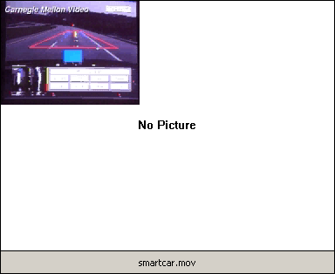
ALVINN

Slide 9
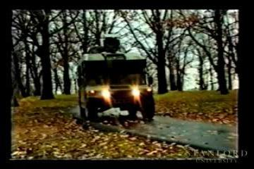
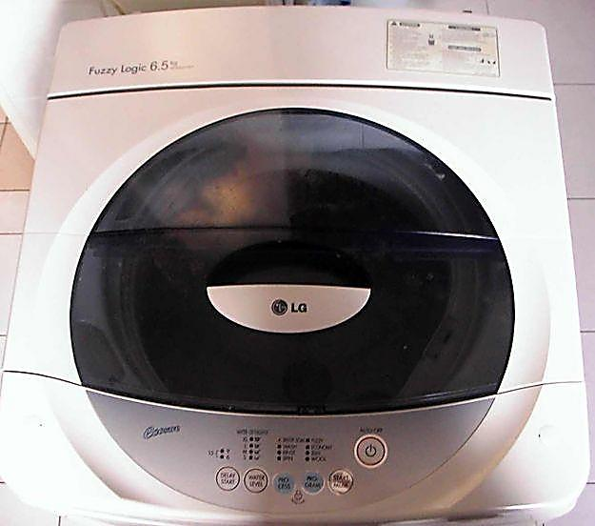
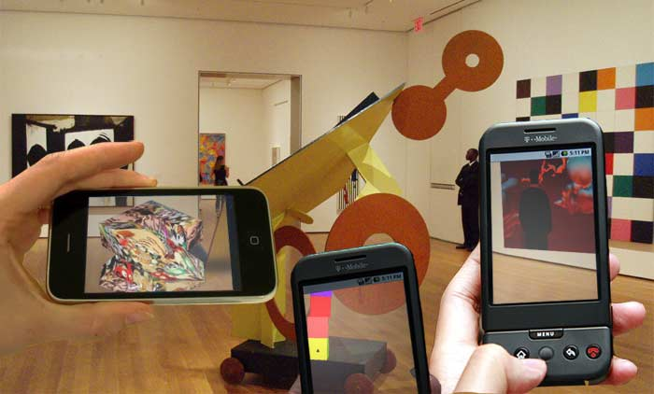
Appliances Control

Slide 10
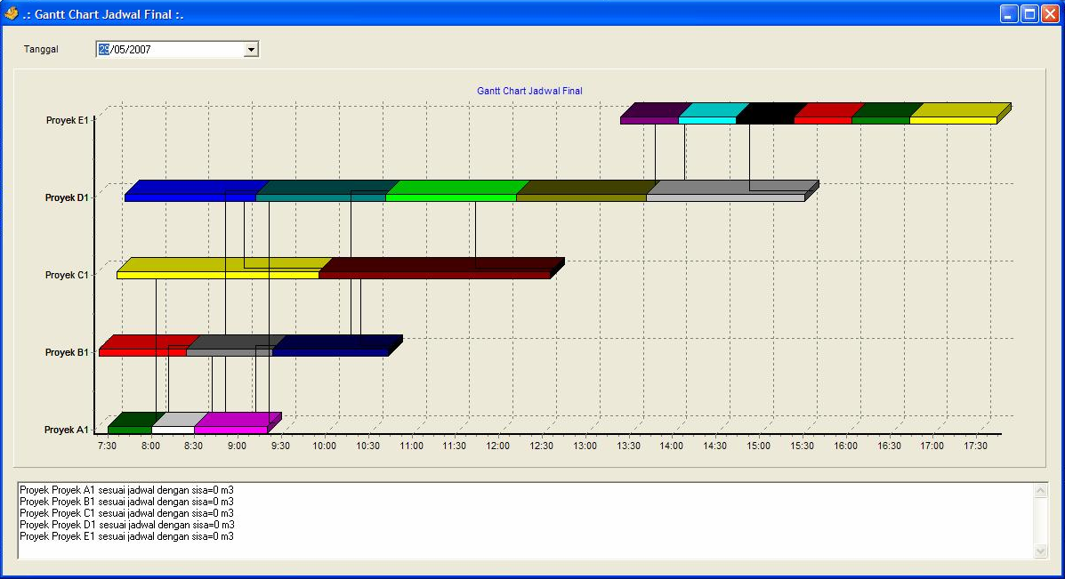
OPTIMASI PENJADWALAN PENGIRIMAN BETON READY-MIX (Genetic Algorithm)

Slide 11
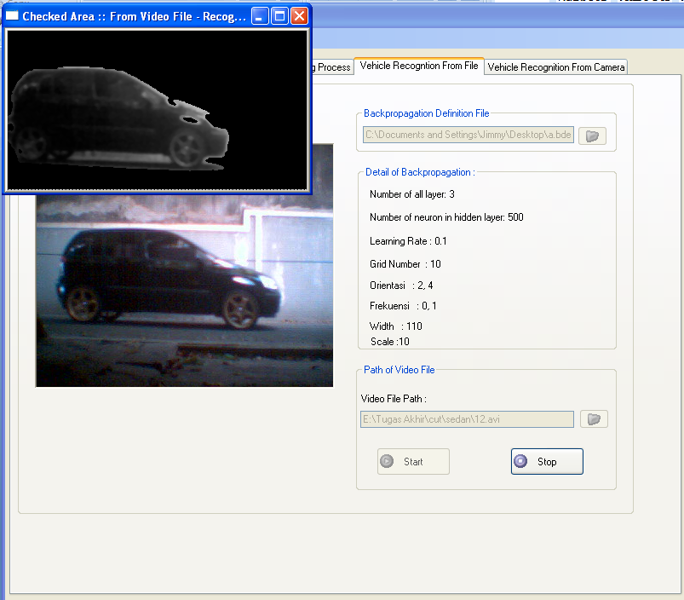
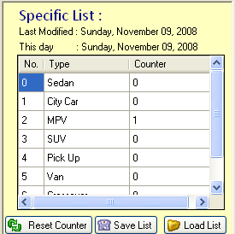
PENGENALAN JENIS MOBIL MENGGUNAKAN KOMBINASI GABOR FILTER DAN JARINGAN SARAF TIRUAN BACK-PROPAGATION

Slide 12
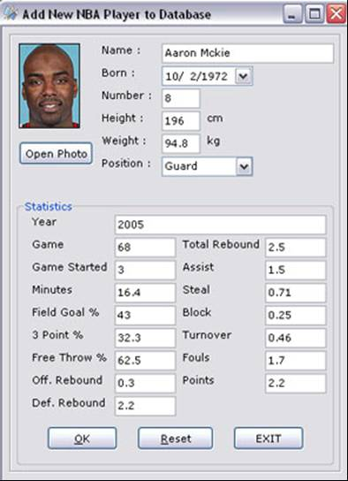
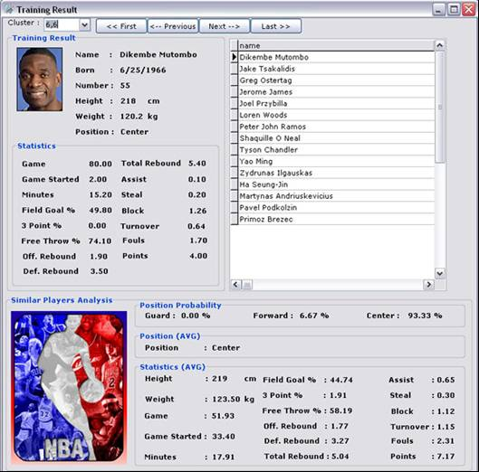
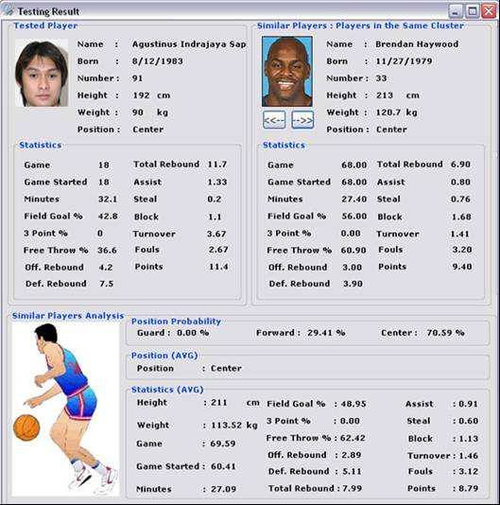
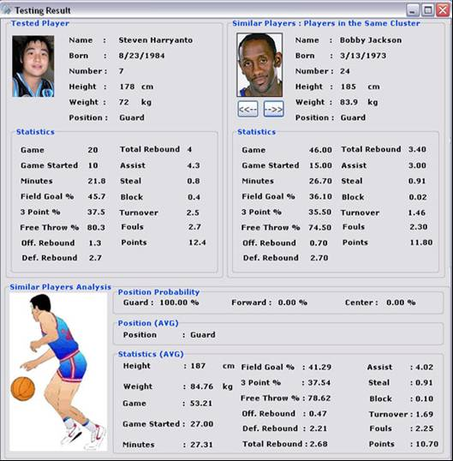
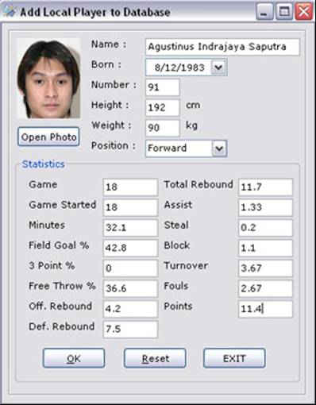
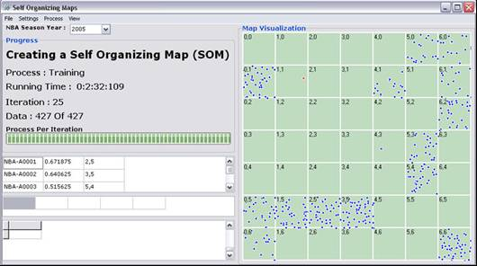
Cluster Analysis untuk Memprediksi Talenta Pemain Basket (Jaringan Saraf Tiruan Self Organizing Map)

Slide 13
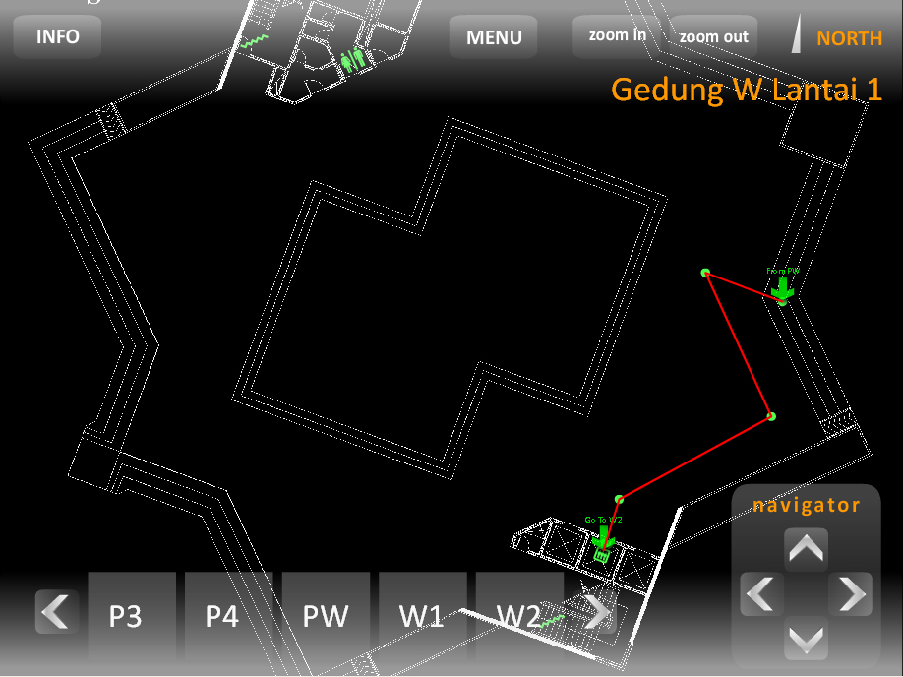
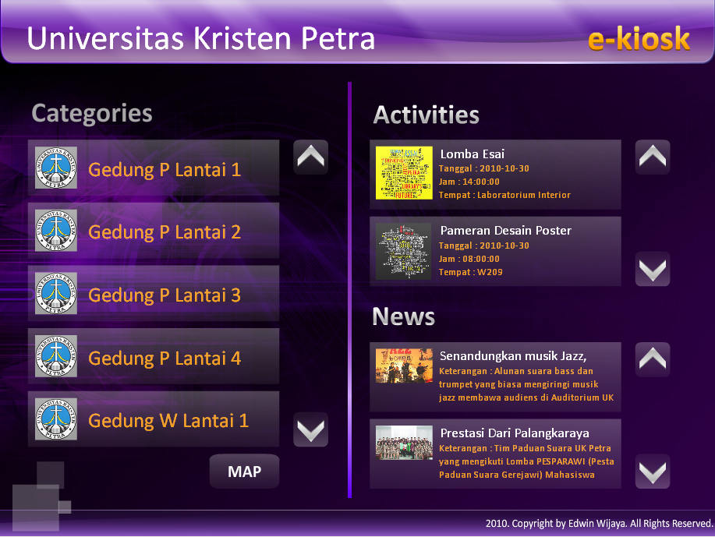
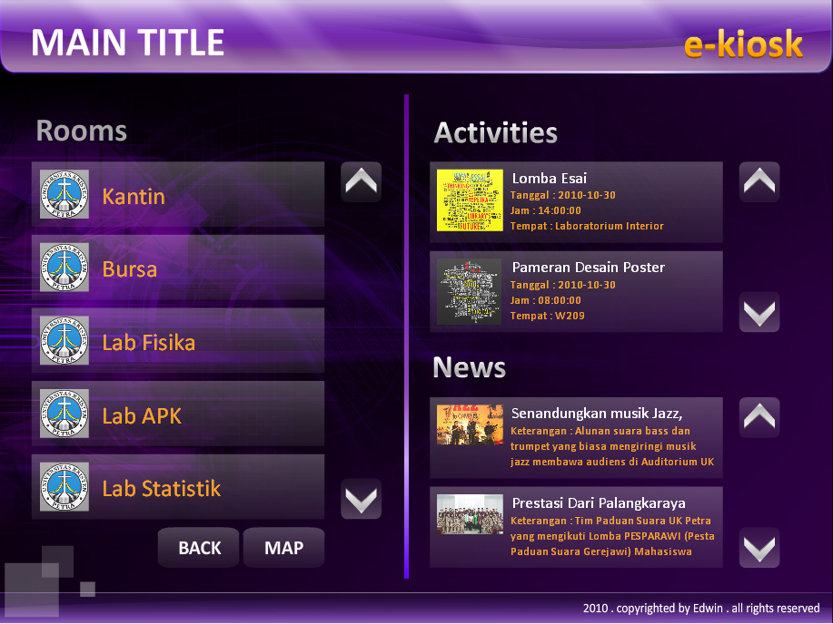
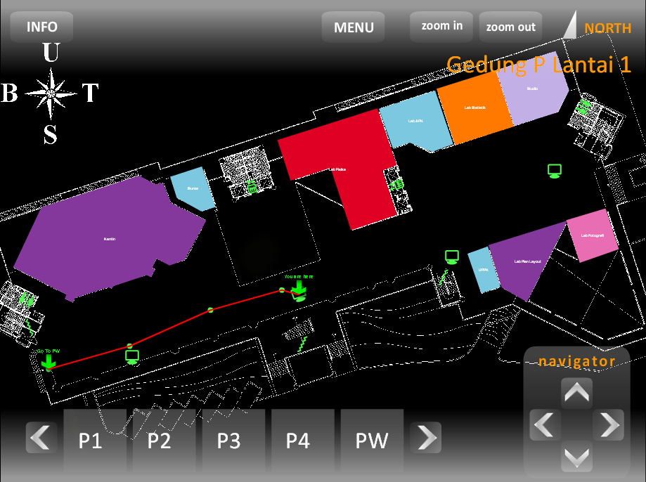
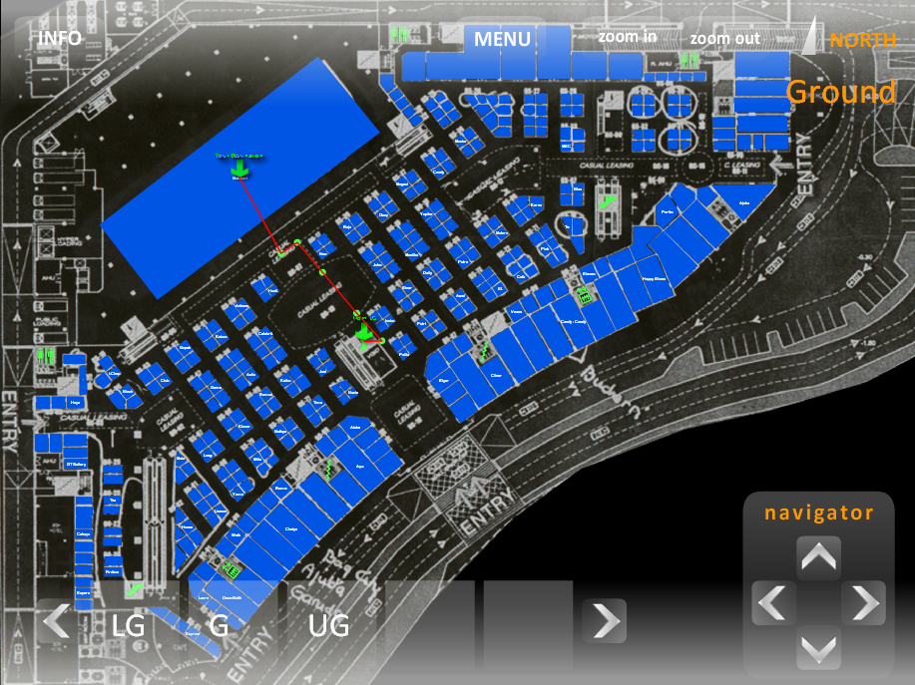
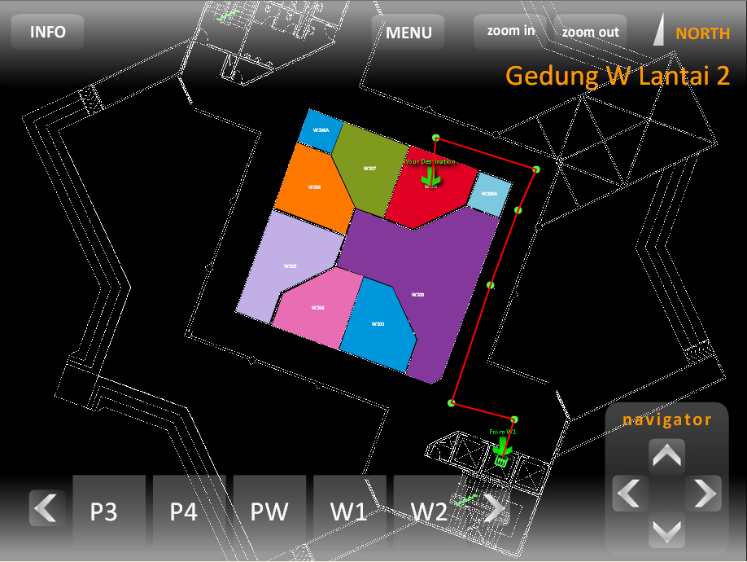
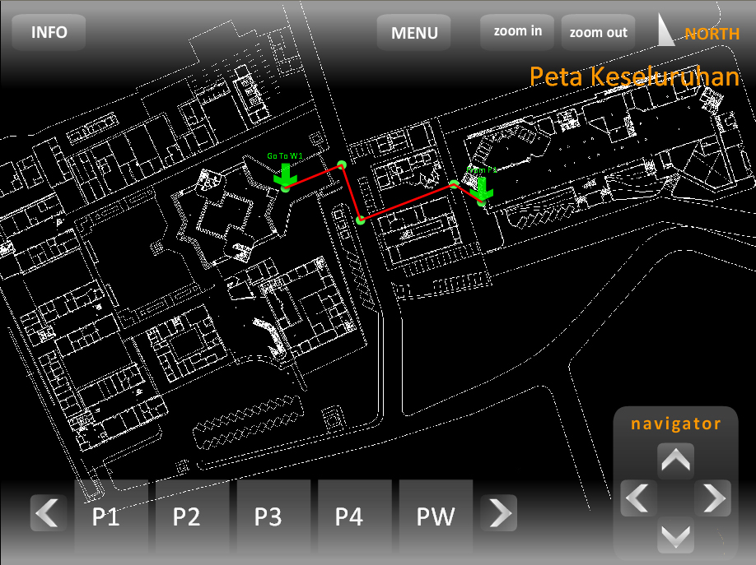
Aplikasi Pencari Lokasi Dan Informasi Ruangan (E-Kiosk) menggunakan A*
C
I
T
O

Slide 14
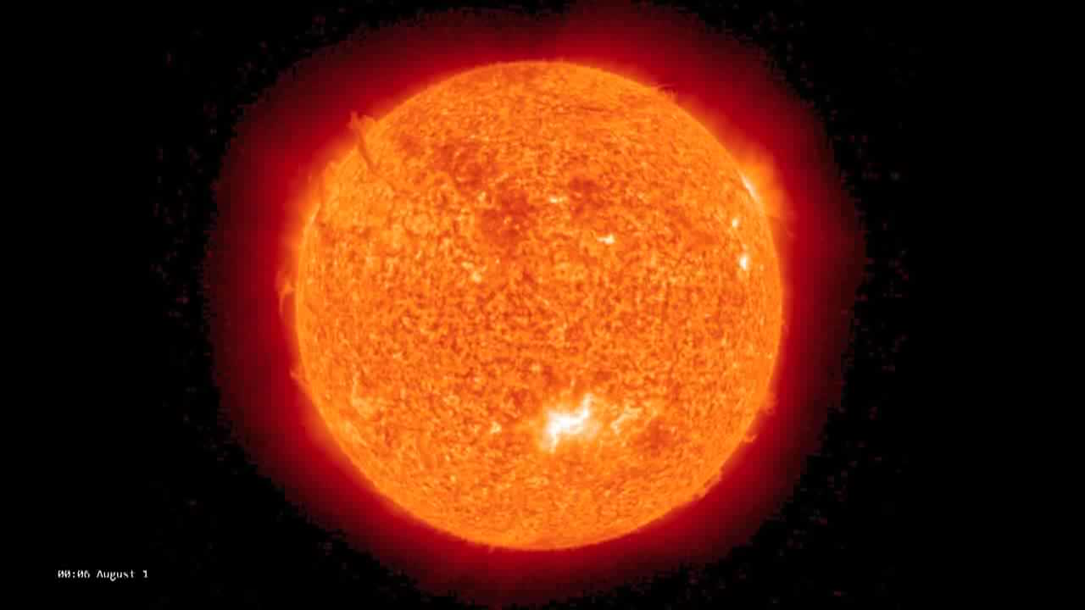
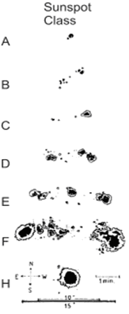
Solar Storm Classification

Slide 15
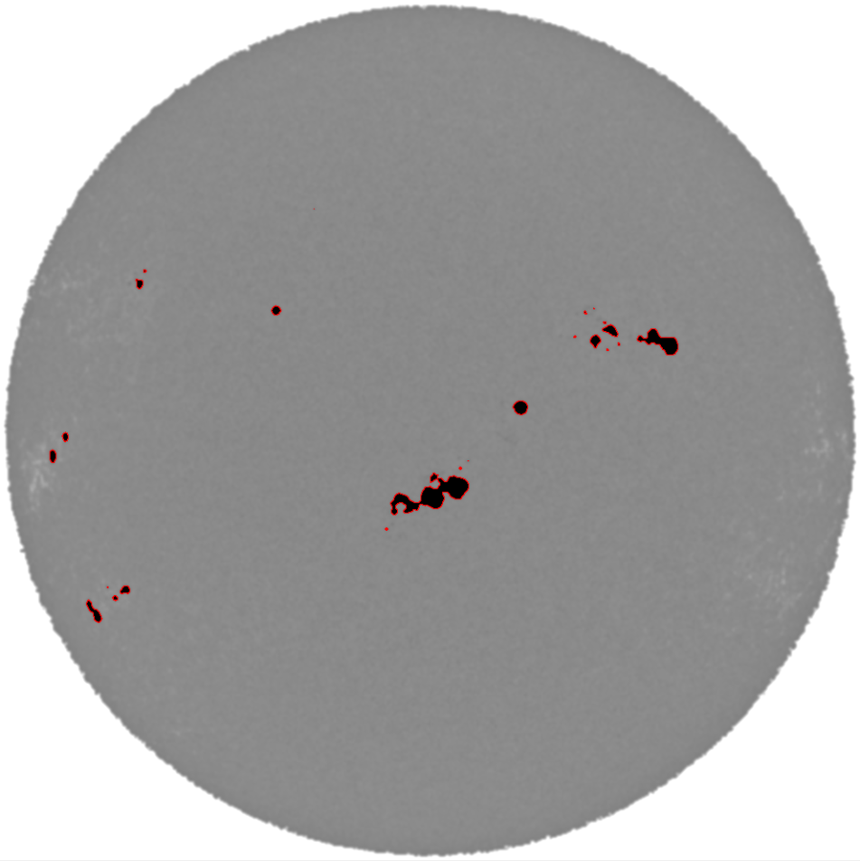
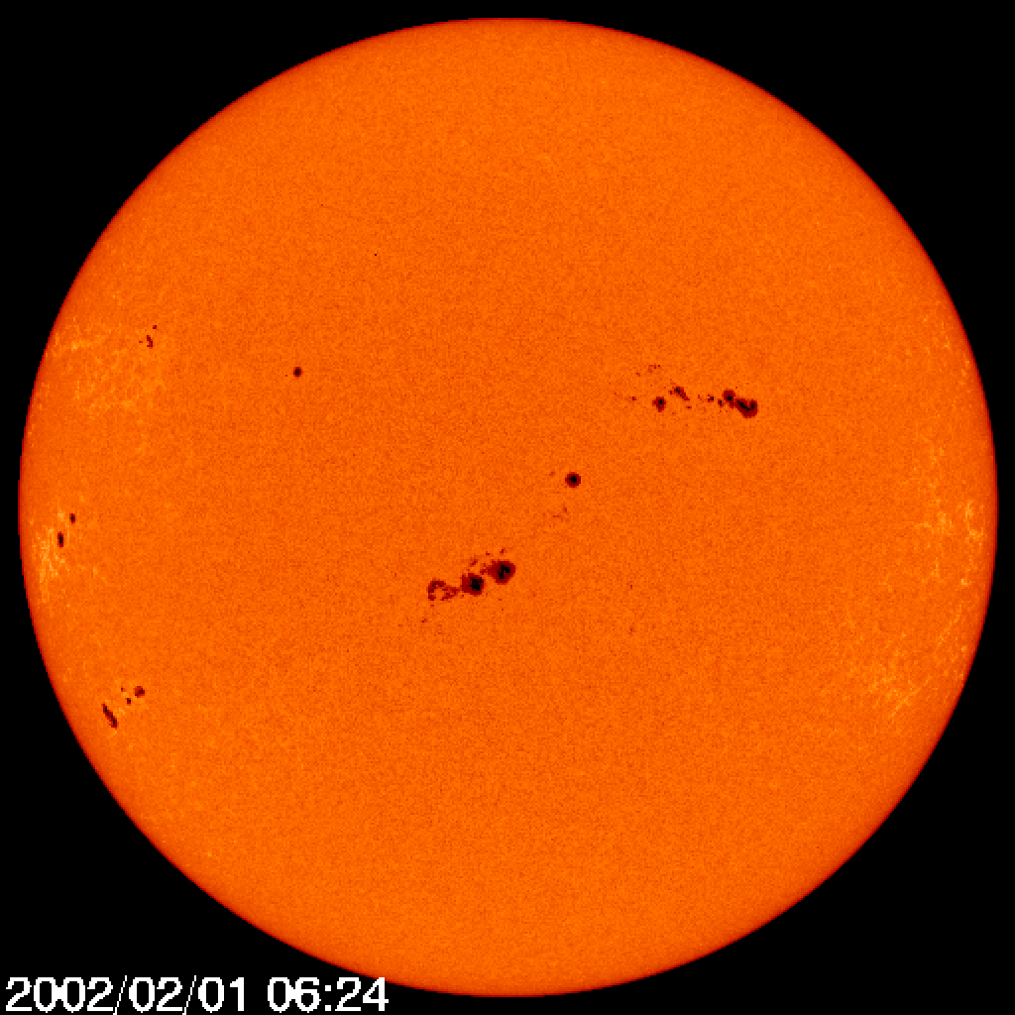
Segmentasi dengan Watershed
Adipranata, R., Budhi, G.S., Setiahadi, B., & Anwar, B., (2010). Segmentasi Bintik Matahari Menggunakan Metode Watershed. Prosiding Konferensi Nasional Sistem & Informatika, Bali.
2/17/2017
Kecerdasan Buatan - Intro

Slide 16
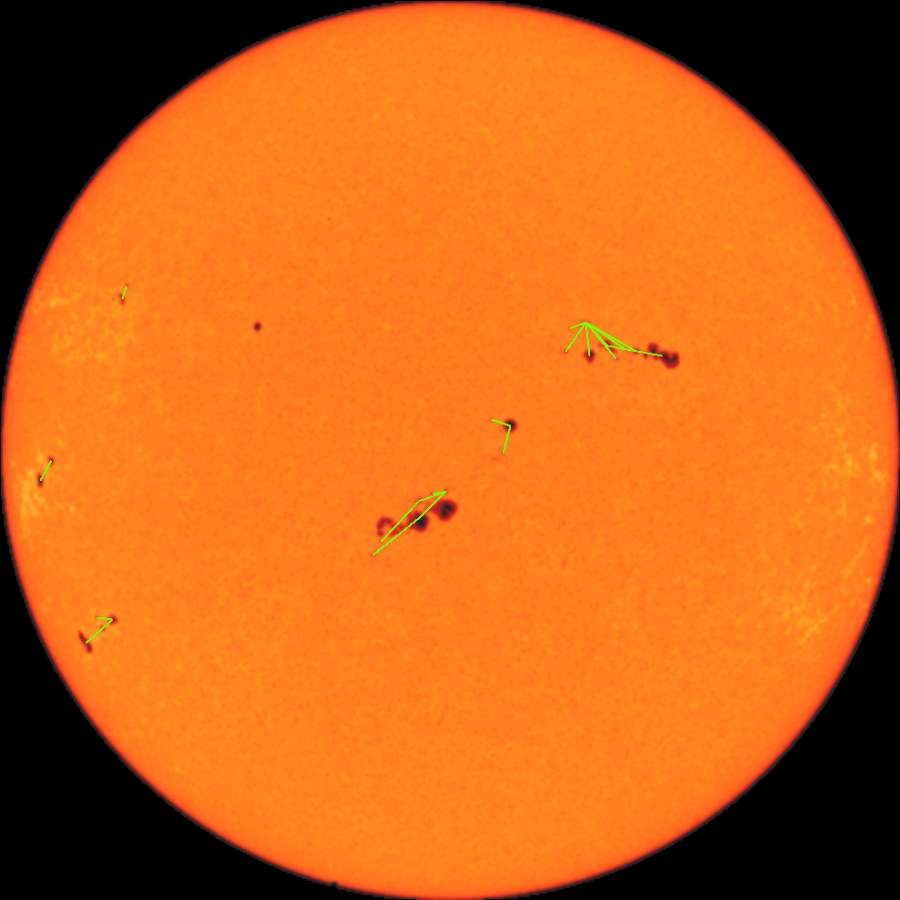

Clustering bintik matahari dengan Db-Scan
Budhi, G.S., Adipranata, R., Sugiarto, M., Anwar, B., & Setiahadi, B., (2011). Pengelompokan Sunspot Pada Citra Digital Matahari Menggunakan Metode Clustering DbScan. Prosiding Seminar Nasional Aplikasi Teknologi Informasi, Yogyakarta.
2/17/2017
Kecerdasan Buatan - Intro

Slide 17
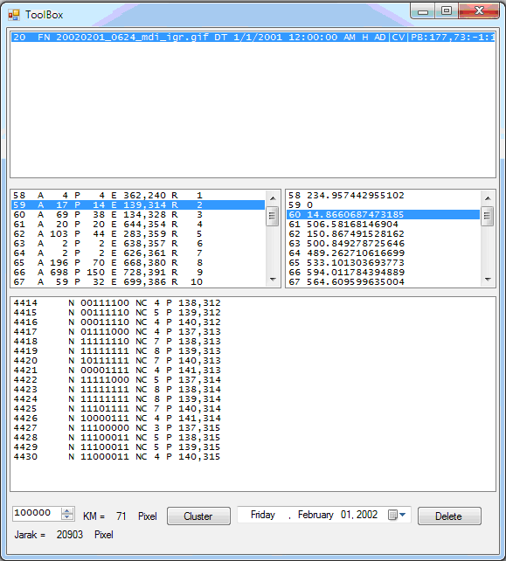
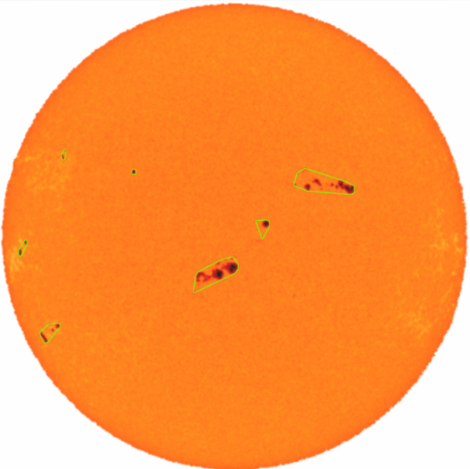


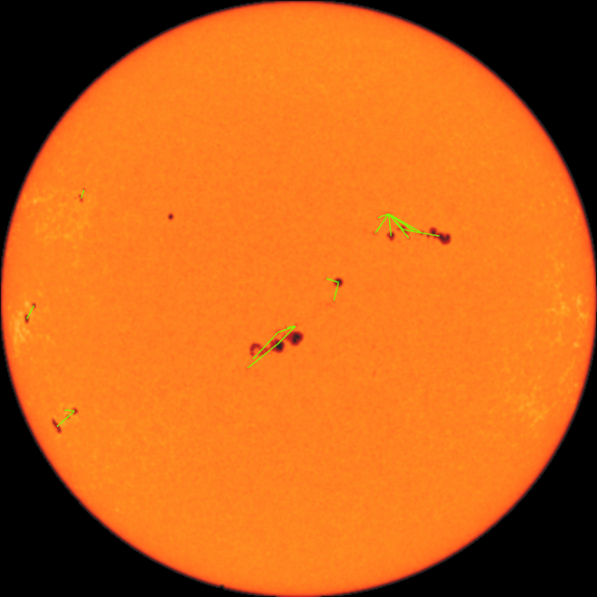

Ekstraksi Fitur
Area
Perimeter / Keliling
Diameter
Jumlah Bintik tiap Cluster
Budhi, G.S., Adipranata, R., Sugiarto, M., Anwar, B., & Setiahadi, B., (2011). Pengelompokan Sunspot Pada Citra Digital Matahari Menggunakan Metode Clustering DbScan. Prosiding Seminar Nasional Aplikasi Teknologi Informasi, Yogyakarta.
2/17/2017
Kecerdasan Buatan - Intro

Slide 18
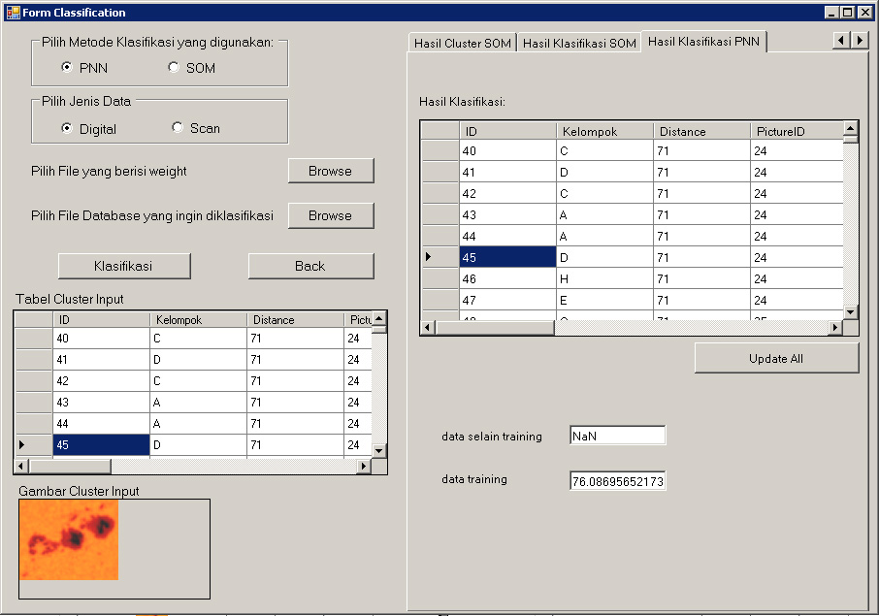
Solar Storm Classification
2/17/2017
Kecerdasan Buatan - Intro

Slide 19
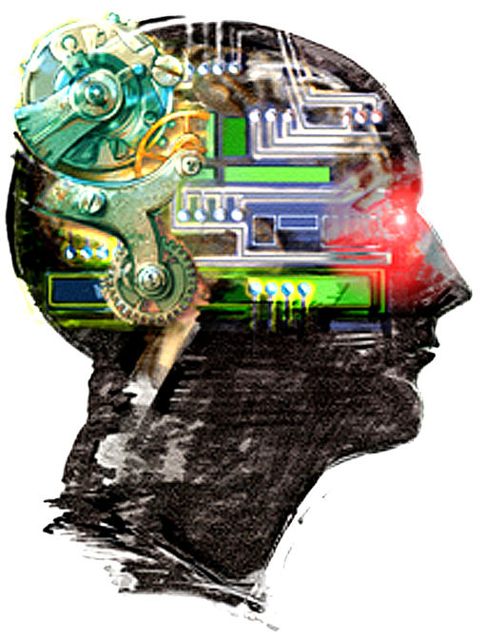


What is AI?

Slide 20
Rational vs Human
Thinking / acting rationally VS
Thinking / acting like a human
Thinking / acting rationally
Rely on logic rather than human to measure correctness
Thinking rationally (logically)
Socrates is a human; All humans are mortal; Socrates is mortal
Acting rationally (logically)
Even if method is illogical, the observed behavior must be rational

Slide 21
Thinking / acting rationally
The general principles of rational agents
Not restricted to human actions and human environments
Not restricted to human thought
Only using laws of logic
Anything goes so long as it produces rational behavior

Slide 22

Acting Humanly: The Turing Test
Alan Turing's 1950 article Computing Machinery and Intelligence discussed conditions for considering a machine to be intelligent
“Can machines think?” ←→ “Can machines behave intelligently?”
The Turing test (The Imitation Game): Operational definition of intelligence.
Computer needs to posses: Natural language processing, Knowledge representation, Automated reasoning, and Machine learning
Problem:
1) Turing test is not reproducible, constructive, and amenable to mathematic analysis.
2) What about physical interaction with interrogator and environment?
Total Turing Test: Requires physical interaction and needs perception and actuation.

Slide 23

What would a computer need to pass the Turing test?
Natural language processing: to communicate with examiner.
Knowledge representation: to store and retrieve information provided before or during interrogation.
Automated reasoning: to use the stored information to answer questions and to draw new conclusions.
Machine learning: to adapt to new circumstances and to detect and extrapolate patterns.
Vision (for Total Turing test): to recognize the examiner’s actions and various objects presented by the examiner.
Motor control (total test): to act upon objects as requested.
Other senses (total test): such as audition, smell, touch, etc.

Slide 24
What tasks require AI?
Definition:
“AI is the science and engineering of making intelligent machines which can perform tasks that require intelligence when performed by humans …”
What tasks require AI?

Slide 25
AI Task Domain
Mundane Task - Perception - Vision - Speech - Heard - Natural Language - Understanding - Generation - Translation - Commonsense reasoning - Robot Control | Formal Task - Games - Chess - Backgammon - Checkers - etc - Mathematics - Geometry - Logic - Integral Calculus - Proving Properties of Program | Expert Task - Engineering - Design - Fault Finding - Manufacturing Planning - Scientific Analysis - Medical Diagnosis - Financial Analysis

Slide 26
How to achieve AI?
How is AI research done?
AI research has both theoretical and experimental sides. The experimental side has both basic and applied aspects.
There are two main lines of research:
One is biological, based on the idea that since humans are intelligent, AI should study humans and imitate their psychology or physiology.
The other is phenomenal, based on studying and formalizing common sense facts about the world and the problems that the world presents to the achievement of goals.

Slide 27


Slide 28
History of AI: 1952- 1969
Great successes!
Logic programs were replicating human logic in many cases
Solving hard math problems
game playing
LISP was invented by McCarthy (1958)
second oldest language in existence
could accept new axioms at runtime
McCarthy went to MIT and Marvin Minsky started lab at Stanford
Both powerhouses in AI to this day

Slide 29
History of AI: 1966 - 1973
A dose of reality – Overhyped
Systems fail to play chess and translate Russian
Computers were ignorant to context of their logic
Problems were intractable
algorithms that work in principle may not work in practice
Combinatorial Explosion / Curse of Dimensionality
Fatal flaw in neural networks was exposed by Marvin Minsky and Seymour Papert
Though flaw was first resolved in 1969, neural networks did not return to vogue until late 1980s

Slide 30
History of AI: 1969 - 1979
Knowledge-based Systems
Previous systems KO because general logical algorithms could not be applied to realistic problems
Answer: accumulate specific logical algorithms
DENDRAL – infer chemical structure
knowledge of scientists boiled down to cookbook logic
large number of special purpose rules worked well
Researchers work on ways to accumulate and store facts for expert systems

Slide 31
History of AI: 1980 - 1987
Let the good times roll
The demonstrated success of AI invited investments
from millions to billions of dollars in 10 years
extravagant AI promises again led to “AI Winter” when investments in technology dropped (1988)
Neural Networks come back from the dead
Hopfield Network(1982), Self Organized-Map / Kohonen(1982), Backpropagation(1986)

Slide 32
History of AI: 1987 - present
AI becomes a science
More repeatability of experiments
More development of mathematical underpinnings
Reuse of time-tested models
Intelligent Agents (1994)
AI systems exist in real environments with real sensory inputs
Niches of AI need to be reorganized

Slide 33
History of AI: Where are We Now?
Autonomous planning:
Scheduling operations aboard a spacecraft
Dante, falls in an ice crater after one step
Mars Rover
Game playing: Kasparov lost to IBM’s Big Blue in chess
Rules were changed to prevent computer from retraining over night and to provide human players with more examples of computerized play

Slide 34
History of AI: Where are We Now?
Autonomous Control: CMU’s NAVLAB drove from Pittsburgh to San Francisco under computer control 98% of time
Logistics: deployment of troops to Iraq
Robotics: remote heart operations
Biology: human genome, protein folding, drug discovery
Information System: stock market, data mining, decision support system

Slide 35
AI State of The Art
Have the following been achieved by AI?
World-class chess playing
Playing table tennis
Cross-country driving
Solving mathematical problems
Discover and prove mathematical theories
Engage in a meaningful conversation
Understand spoken language
Observe and understand human emotions
Express emotions
…

Slide 36
Branches of AI
Logical AI
Search
Natural language processing
pattern recognition
Knowledge representation
Inference From some facts, others can be inferred.
Automated reasoning
Learning from experience
Planning To generate a strategy for achieving some goal
Epistemology This is a study of the kinds of knowledge that are required for solving problems in the world.
Ontology Ontology is the study of the kinds of things that exist. In AI, the programs and sentences deal with various kinds of objects, and we study what these kinds are and what their basic properties are.
Genetic programming
Emotions???
…

